Slide 1


Slide 2
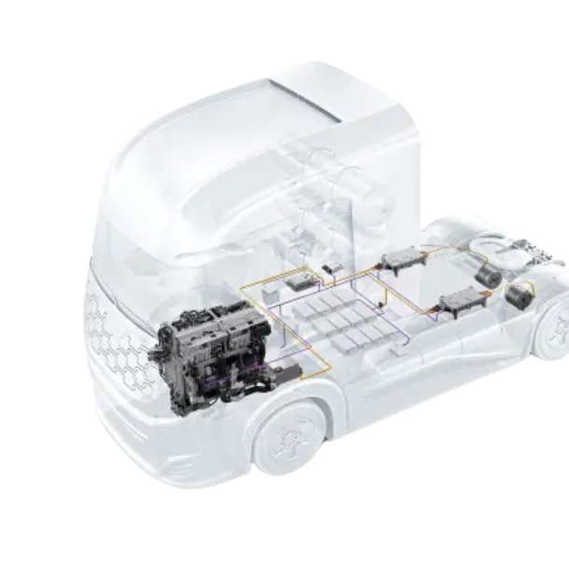
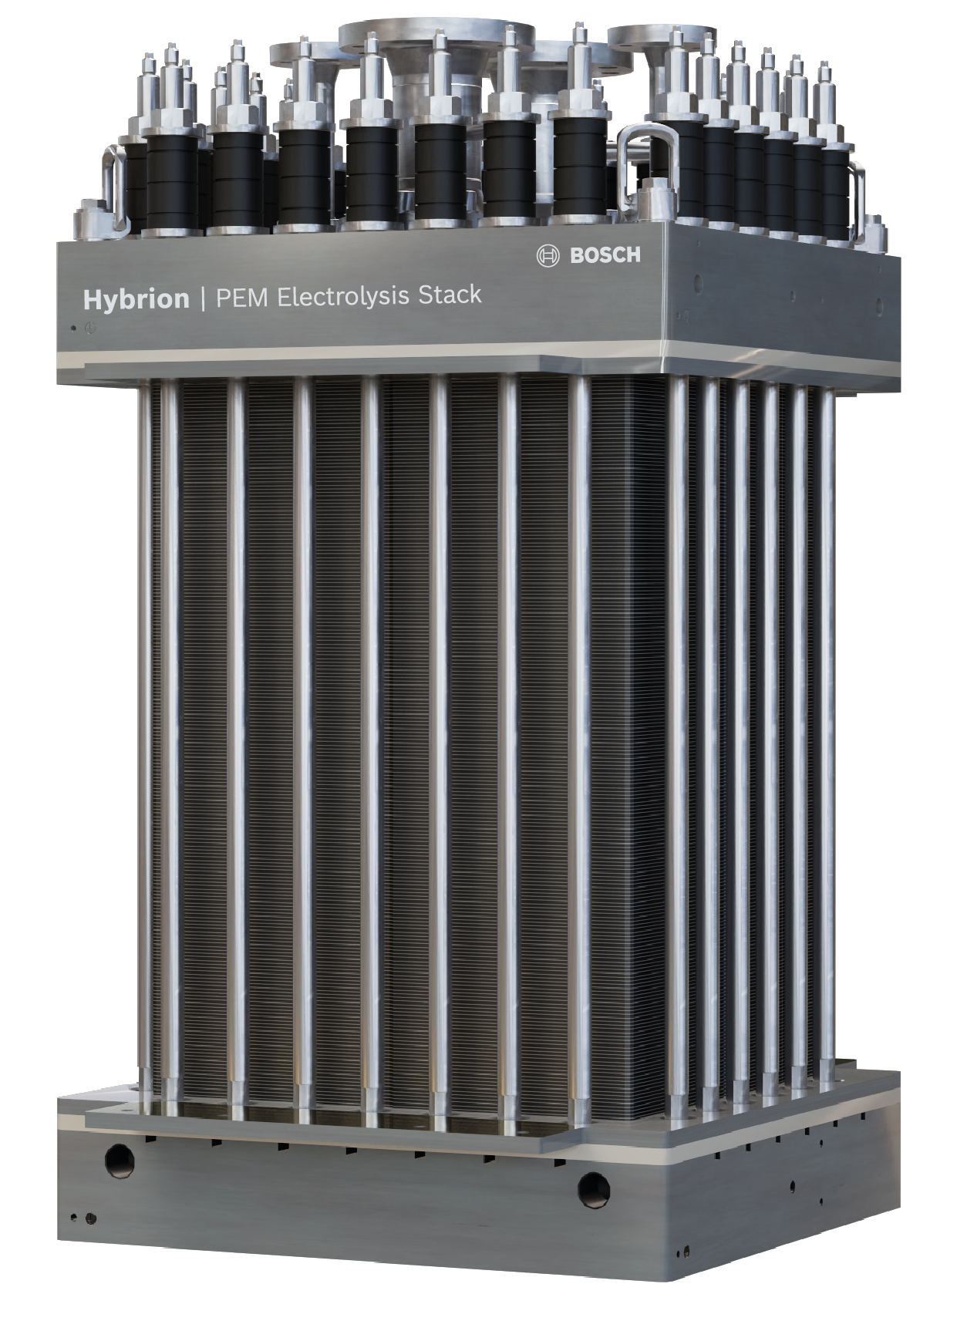

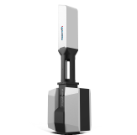
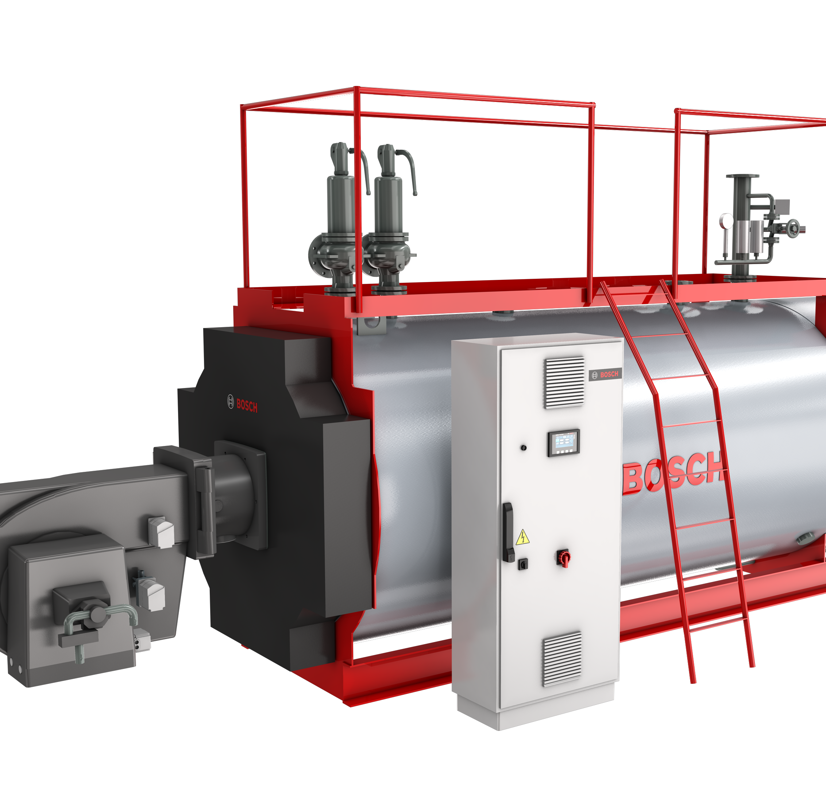
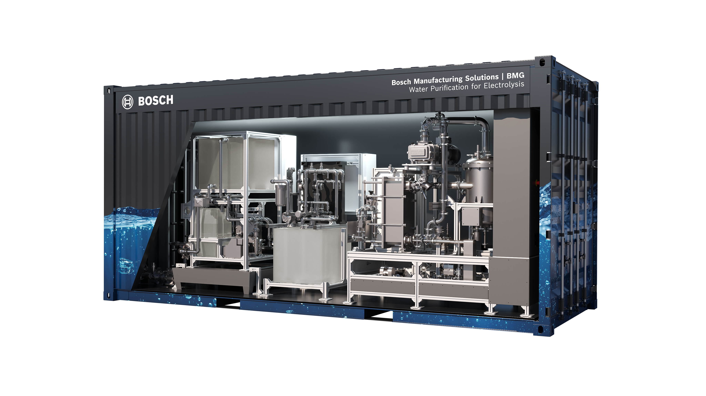
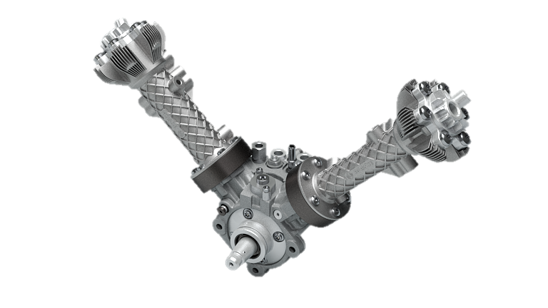
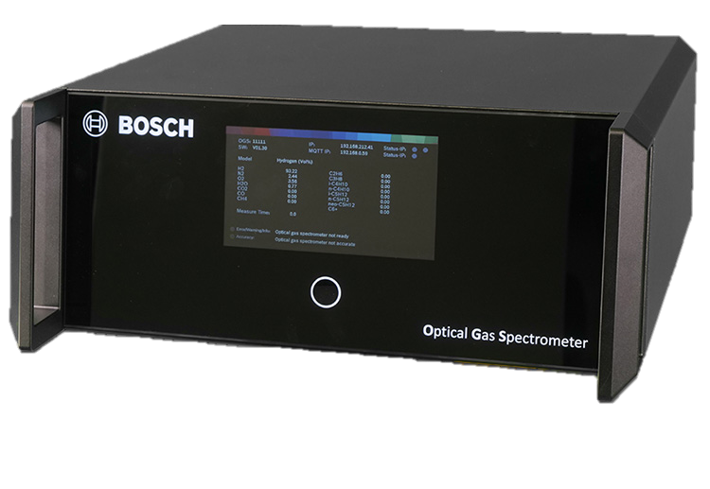
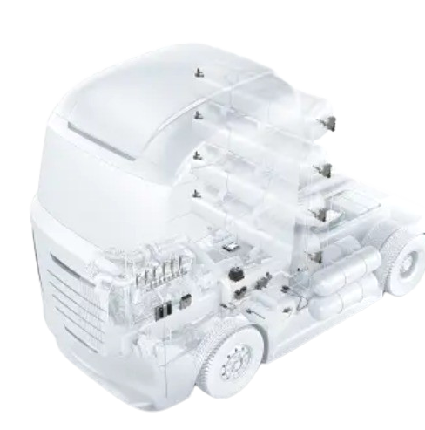



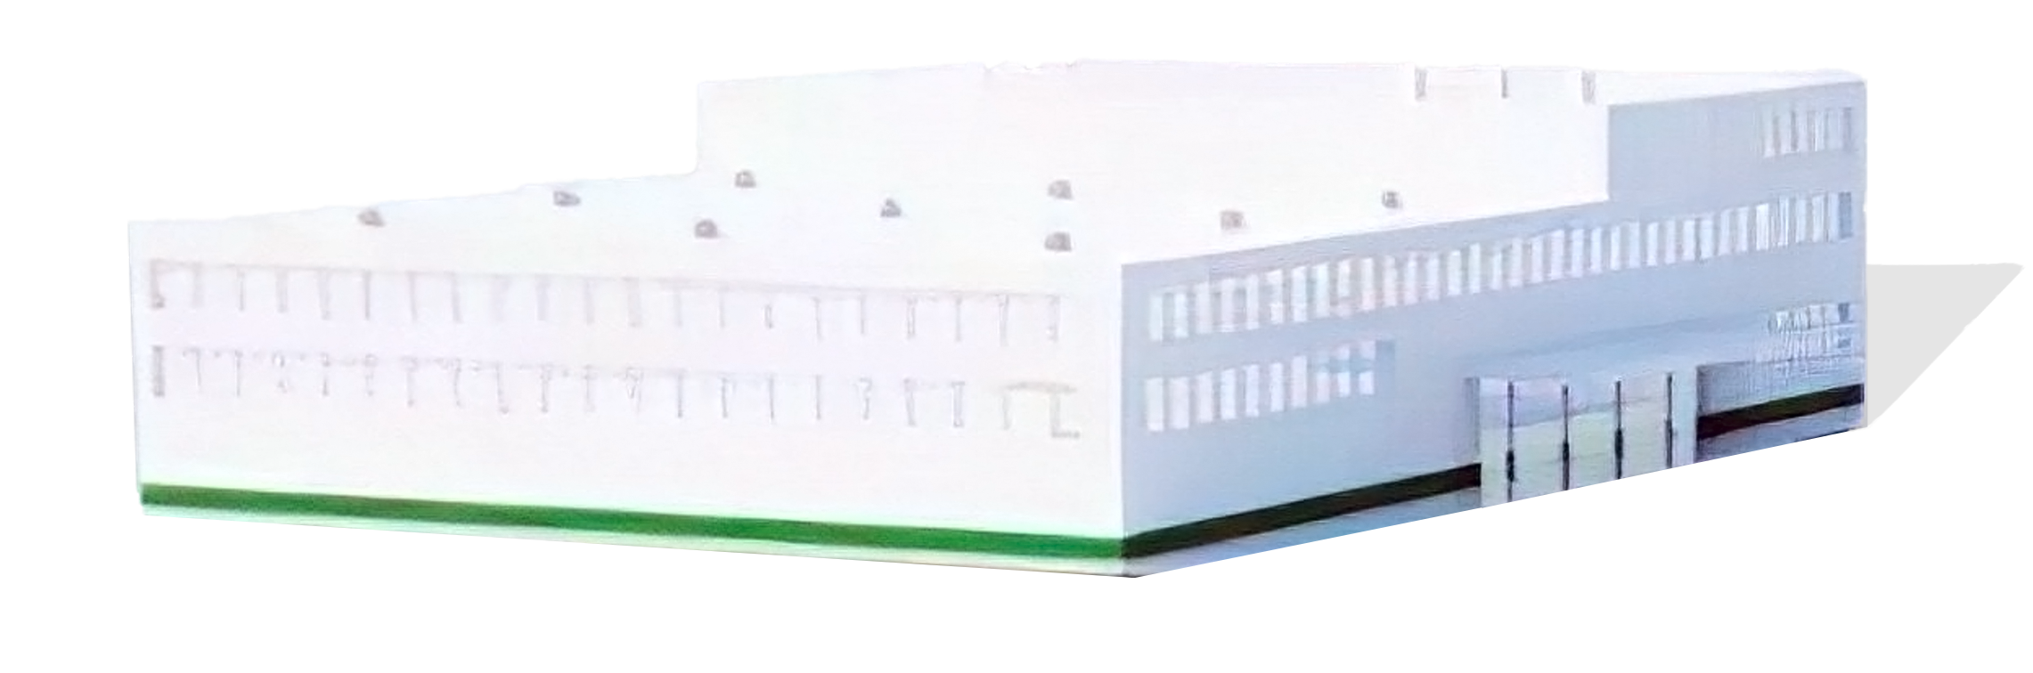
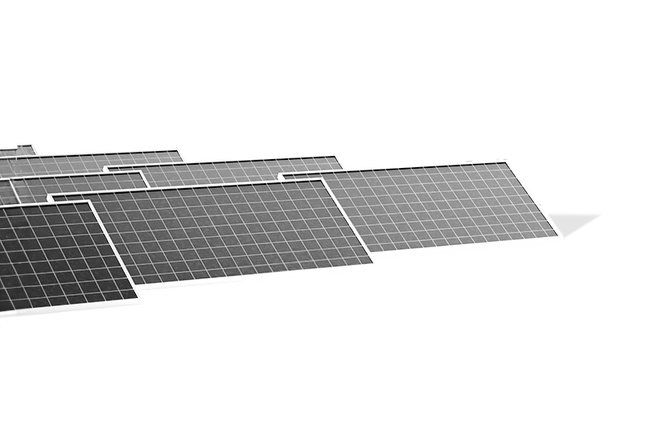


Bosch H₂ portfolio
brings in the maximum knowledge span
Production
Storage & Distribution
Usage
Water
purifier
PEM electrolysis
stack
Optical gas
spectrometer
Compact
gas compressor
Hydraulic
compressor
CryoPump
Universal steam boiler
Fuel cell
engine
2
3
H₂
combustion
engine
2

Slide 3
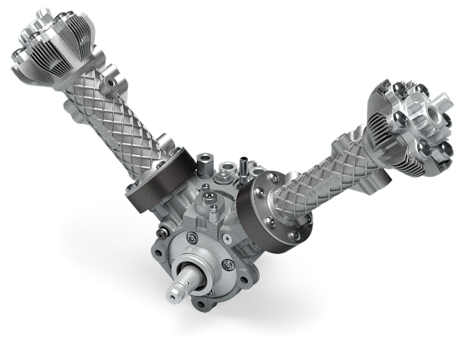
Bosch compact gas compressor

Slide 4







compact, lightweight, robust
Bosch compact gas compressor
H
≥11 Nm³/h
≤5.0 gas purity
hydrogen output
by hermetic sealing
Up to 350 bar
hydrogen outlet pressure
flexible scalability
drive sub-modules by
e-motor + gearbox
durable drive
<12 kg
from automotive applications
compact and lightweight
Bosch is currently in the development phase for the compact gas compressor. All technical specifications and milestones given in this informational document are development objectives.

Slide 5




















hydrogen use cases
Bosch compact gas compressor
H
H
stationary power generation (energy/heat coupling)
small scale energy storage & laboratories
100 kW
350
metal hydride storage (~60bar)
p
[bar]
H2 Transport

0
(700)
H2 generation
H
H
laboratories & testing facilities
manufacturing, agriculture, hospitals, universities & schools,
backup-power, intralogistics & heat
up to ~1.000 kW
high pressure storage (stationary)
(local) H2 supply network
≥11 Nm³/h (1kg/h) per compressor unit
Indutry processes
up to 35bar intermediate storage tank
H₂
+ + + …
scalability by parallel installation
municipal fleets &
utility providers
up to 5.000 kW
small filling stations (incl. high pressure storage tanks)
private fleets, fork lifter, agriculture
Electrical power source
Source of hydrogen
Value-add by compressor
Application
Market segment

Slide 6













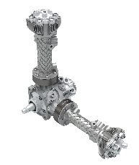
hydrogen use cases
Bosch compact gas compressor
SEGMENT
residential
commercial
energy
USE CASE
single family homes
multi family homes & quarters
manufacturing, agriculture,
hospitals, universities & schools
backup-power, intralogistics & heat
ELY‘s for power grid stabilization
municipal H₂ production & usage
ELY POWER
1-5KW
5-50KW
<50KW-1MW
1-5MW
1-5MW
scaling of compression units =
high redundancy of compression system
controllability in a wide operating range
availability even during maintenance operation

Slide 7
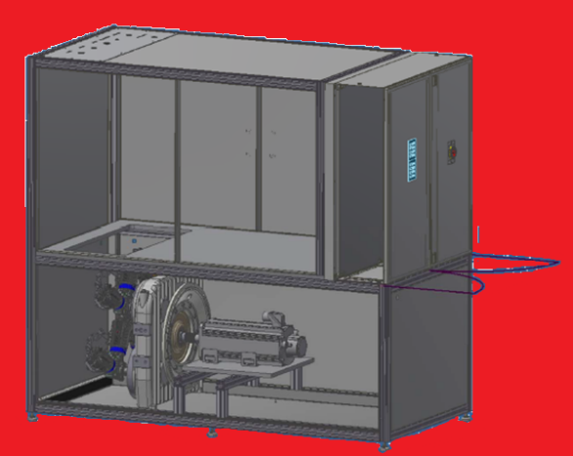
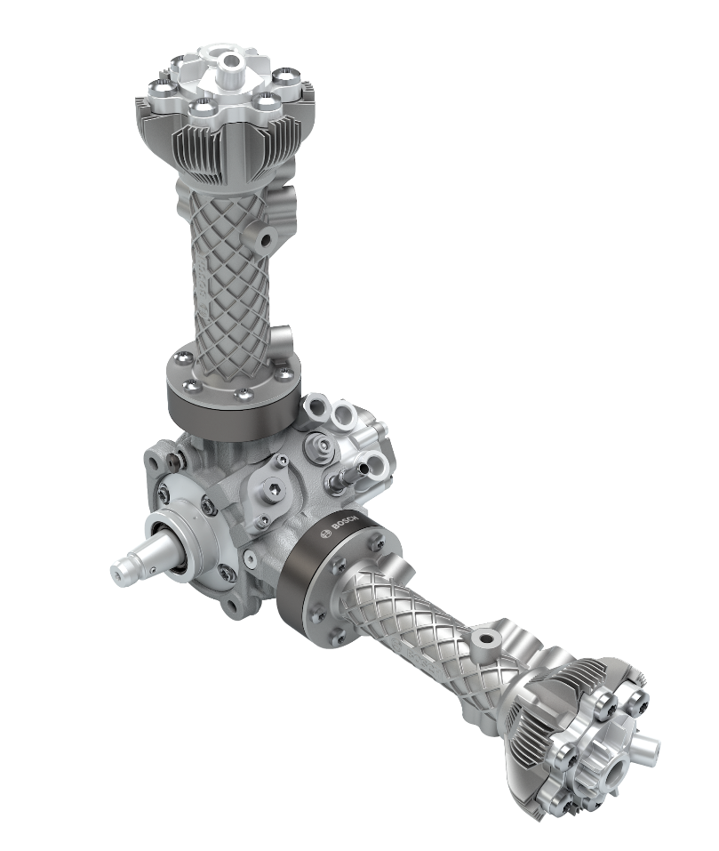
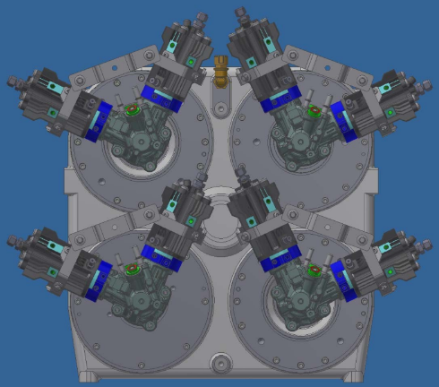

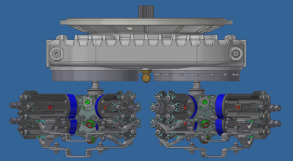
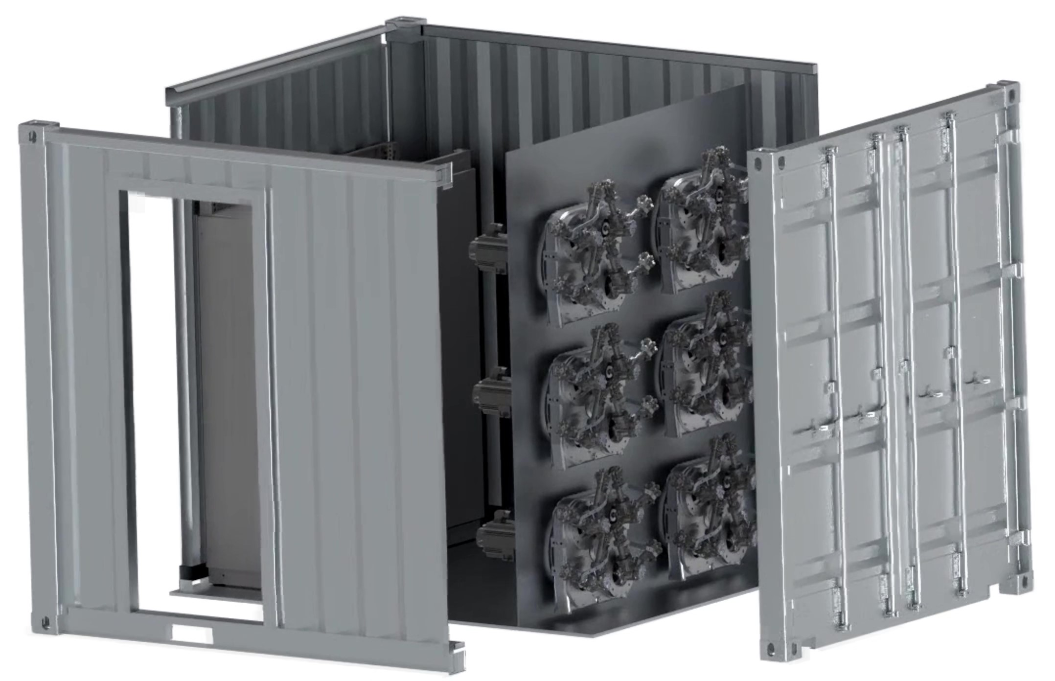
scalability + modularity = redundancy
Bosch compact gas compressor
small stationary & mobile applications
larger scale stationary applications
1x...
6x
1..2x
4x
Cabinet & container integration
incl. SPS control
Rack integration
Compression unit
Drive unit

Slide 8
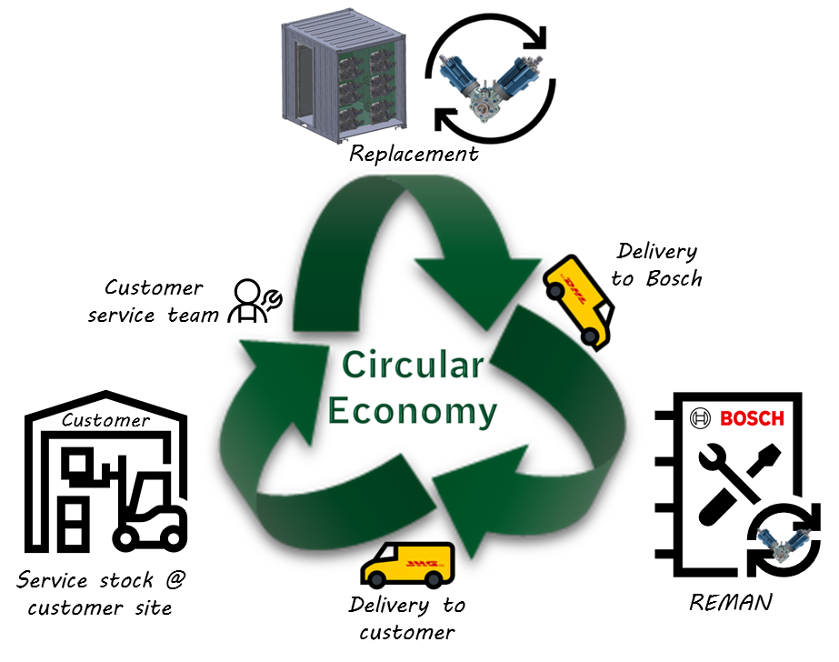
Circular Economy with remanufacturing concept
Bosch compact gas compressor
redundant layout
easy handling
proven quality
competitive cost

Slide 9

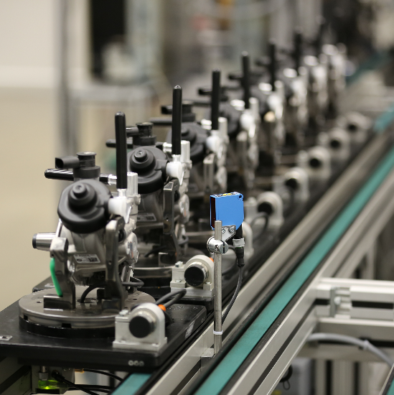

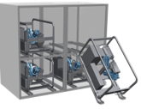






Efficiency throughout the lifecycle
Bosch compact gas compressor
compression efficiency | cost efficiency | efficiency by uptime | service efficiency
the power pack high power density excellent delivery performance | automotive heritage production know-how quality and reliability competitive cost | redundant layout redundancy by modularity operation during service | fast replacement lightweight & handy circular economy & REMAN

Slide 10


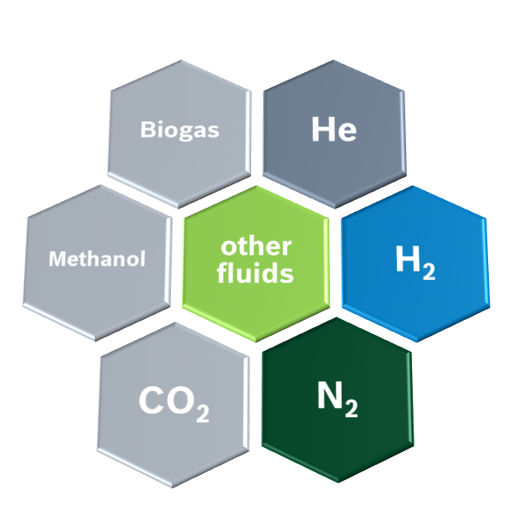




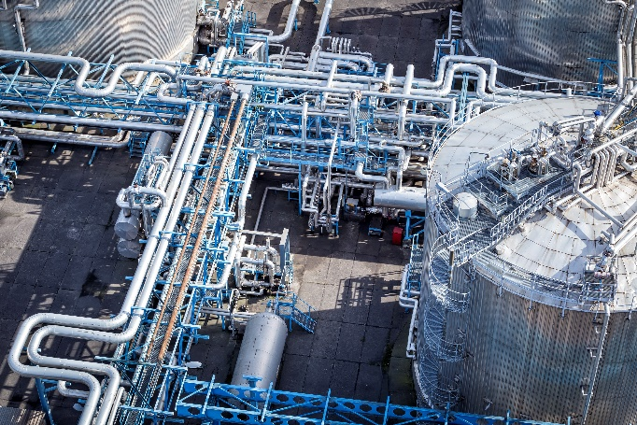

industry applications
Bosch compact gas compressor
CV & off-highway
PtX applications
manufacturing
chemical industry
gensets
Methanol
shipping
intralogistics
food & beverage
pharma industry
agriculture
railway

Slide 11
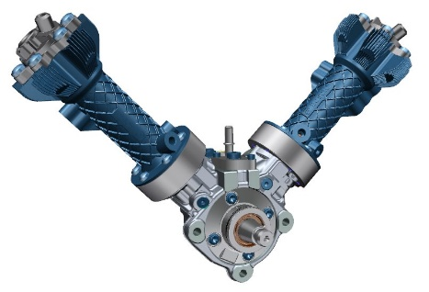
specifications
Bosch compact gas compressor
Compact Gas Compressor |  | „V-module“ | comment
Delivery rate for hydrogen | Nm³/h kg/h | ≥11 ≥1 | variable compressor speeds allow variable delivery rates up to ≥11Nm³/h
Gas purity |  | H2 5.0 (>99,999%)
Weight | kg | <12
Dimensions | mm | 420 x 420 x 200
Inlet pressure | bar | 15…35 | further development w/ target inlet pressure ≥5bar
Stages |  | 2
Max. discharge pressure | bar | 300+ | depending on inlet pressure
Gas inlet temperature | °C | 5…45 | Option for 60Hz
Ambient temperature | °C | -40…60 | operation allowed, target: > -30°C
Cooling |  |  | active oil- and air- or water cooling
Speed | rpm | 400…800 (1000)
Electric power | kW | <3
Bosch is currently in the development phase for the compact gas compressor. All technical specifications and milestones given in this informational document are development objectives.

